Slide 1
Dementia & Reducing the Risk
Cecilia Craig
Education Officer
Dementia Services Information & Development Centre

Slide 2
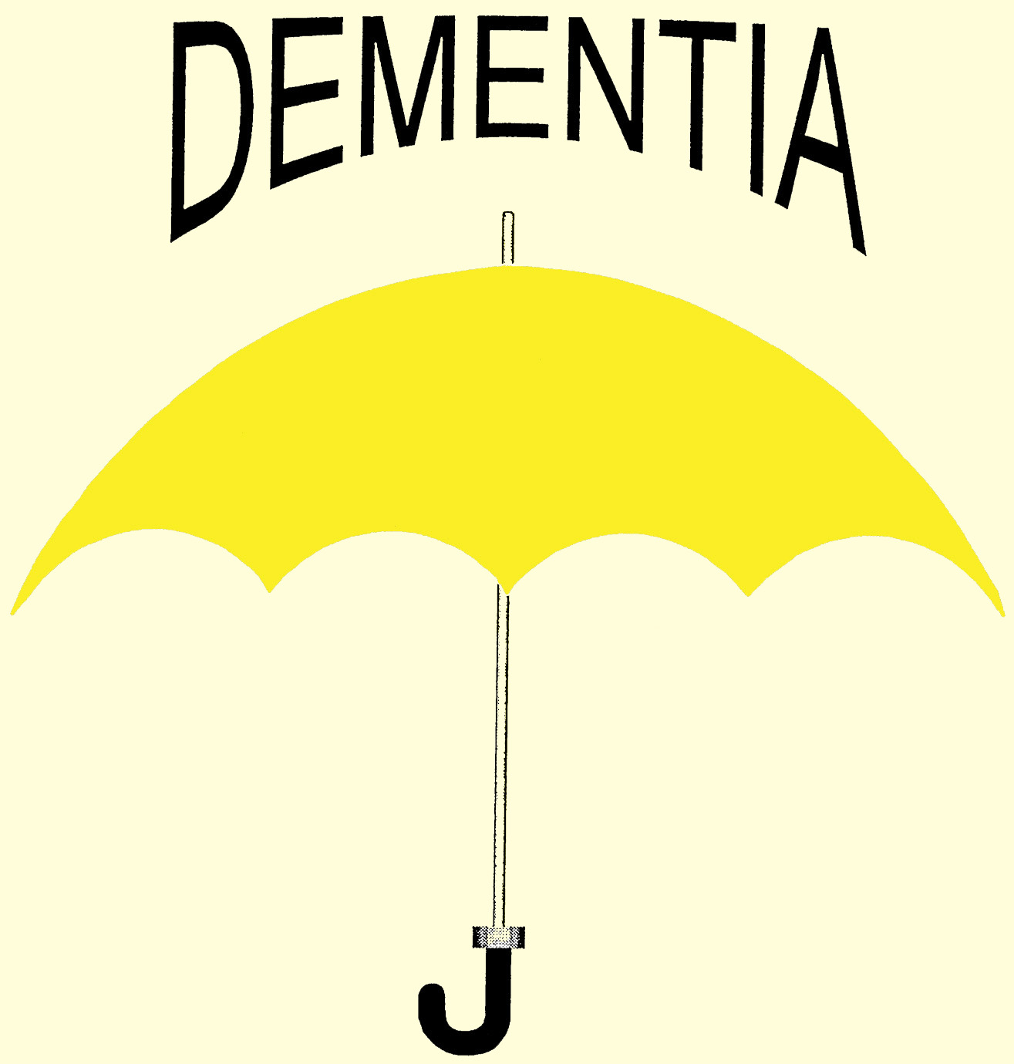
Common
Less common
% Approx
90%
10%
Frontotemporal lobe:
Pick’s Disease
Alzheimer's Disease (60%)
AIDS Dementia Complex
Vascular Dementia (20%)
Korsakoff’s Dementia
Lewy Body Dementia (15%)
Creutzfeldt-Jakob Disease
Notes:
Parkinson’s
Prevalence = 24-31%
PDD = 3-4% of the dementia population
CJD
No new cases.
178 in UK up to 2016
Korsakoff’s
Rare
AID’s Dementia Complex
Not certain

Slide 3
DEMENTIA IS …
Any disorder causing brain destruction …
… leading to functional loss of those cells.
Results in difficulties in:
Cognitive
Social
Physical activities of daily living.
A gradual process usually.

Slide 4
DEMENTIA IS …
A disability characterised by:
Impaired Memory
Impaired Reasoning
Impaired Ability to Learn
High Level of Stress
Acute Sensitivity to Social & Built Environment (Marshall, M. 1997)

Slide 5
What is affected?
Physical abilities:
Eating
Drinking
Moving
Sleeping
Walking etc..

Slide 6
What is affected?
Thinking abilities:
Remembering
Reasoning
Thinking
Planning
Judgement
Calculation
Problem solving
Concentration

Slide 7
What is affected?
Social abilities:
Communicating with others
Maintaining relationships
Work performance
Social etiquette

Slide 8
What are the Risk Factors for Dementia?

Slide 9
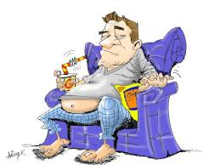
AGE
FAMILY History
GENDER
LIFESTYLE
GENETIC
MEDICAL Conditions

Slide 10
AGE
As you age –
the risk increases

Slide 11
FAMILY History
A family history
increases
the risk
Ethnicity:
– Sth. Asian and African-Caribbean origin
Increased risk for …
vascular diseases and diabetes.

Slide 12
Genetic
RARELY…
Certain genes increase the risk:
Presenilin 1, 2 & APP genes (significant)
ApoE4 on chromosome 19 (high)
Down syndrome (high)
Notes:
Some diseases are caused by a genetic mutation, or permanent change in one or more specific genes. If a person inherits from a parent a genetic mutation that causes a certain disease, then he or she will usually get the disease.
In other diseases, a genetic variant may occur. This change in a gene can sometimes cause a disease directly. More often, it acts to increase or decrease a person's risk of developing a disease or condition. When a genetic variant increases disease risk but does not directly cause a disease, it is called a genetic risk factor.
Familial Alzheimer’s Disease (eFAD)
Three known genes:
Amyloid precursor protein (APP)
Presenilin 1 (PS1) Accounts for most of eFAD
Presenilin 2 (PS2)
Certain to develop Alzheimer’s disease.
Of these, PS1 mutations is most common, while APP and PS2 are rarer.
The APOE gene provides instructions for making a protein called apolipoprotein E.
The e4 version of the APOE gene increases an individual's risk for developing late-onset Alzheimer disease. People who inherit one copy of the APOE e4 allele have an increased chance of developing the disease; those who inherit two copies of the allele are at even greater risk. The APOE e4 allele may also be associated with an earlier onset of memory loss and other symptoms.
It is not known how the APOE e4 allele is related to the risk of Alzheimer disease. However, researchers have found that this allele is associated with an increased number of protein clumps, called amyloid plaques, in the brain tissue of affected people. A buildup of toxic amyloid beta peptide and amyloid plaques may lead to the death of neurons and the progressive signs and symptoms of this disorder.
It is important to note that people with the APOE e4 allele inherit an increased risk of developing Alzheimer disease, not the disease itself. Not all people with Alzheimer disease have the APOE e4 allele, and not all people who have this allele will develop the disease.
Down Syndrome
The reason Alzheimer's disease is more common in people with Down syndrome is not completely known. Alzheimer's disease is associated with increased production of a compound called amyloid beta in the brain. Amyloid beta accumulates and causes loss of brain cells called neurons. Exactly how neuron loss occurs is not well understood. The higher risk for Alzheimer's disease in people with Down syndrome may be related to the extra copy of chromosome 21 (which causes Down syndrome) because it leads to increased production of amyloid beta.
Higher prevalence of Alzheimer's in people with Down syndrome
Studies suggest that more than 75 percent of those with Down syndrome aged 65 and older have Alzheimer's disease, nearly 6 times the percentage of people in this age group who do not have Down syndrome.
Down syndrome is a condition in which a person is born with extra genetic material from chromosome 21, one of the 23 human chromosomes. Most people with Down syndrome have a full extra copy of chromosome 21, so they have three copies instead of the usual two. In ways that scientists don't yet understand, the extra copies of genes present in Down syndrome cause developmental problems and health issues. Scientists think that the increased risk of dementia in individuals with Down syndrome may also result from the extra gene.
As with all adults, advancing age also increases the chances a person with Down syndrome will develop Alzheimer’s disease. Because people with Down syndrome live, on average, 55 to 60 years, they are more likely to develop younger-onset Alzheimer’s (Alzheimer’s occurring before age 65) than older-onset Alzheimer’s (Alzheimer’s occurring at age 65 or older).

Slide 13
MEDICAL Conditions
Vascular disease
Repeated head injuries
Diabetes Type 2
Depression
Others e.g. Parkinson, MS …
all increase the risk

Slide 14
GENDER
Females are
slightly more
at risk

Slide 15
LIFESTYLE
Diet - cholesterol
- vitamin D etc…
Social isolation
Smoking
Alcohol
Sedentary Lifestyle

Slide 16
How can the risk be reduced?
Video

Slide 17
Parachute from a plane
Join Toastmasters
Challenge yourself
Change something in
your life
Learn something new
Routine
Visit new places
A language
Guitar

Slide 18
Swim
Run
Low fat
Low alcohol & no smoking
Exercise
Healthy Diet
Socialise
Walk
Fruit & Veg
Engage in social activities
Meet people

Slide 19
Eliminate Stressors
7-8 hrs sleep
Stress
Sleep
Rest
Improve Coping Skills
Mental & Physical Rest

Slide 20
Reduce your RISK
Remember …
Increase your RESERVE

Slide 21
TYPES …
Alzheimer’s type dementia (50-70%)
Vascular dementia (10-20%)
Mixed dementia (15-20%)
Lewy Body dementia (15%)
Other (10%)

Slide 22
Alzheimer’s Dementia
Cause – unknown, insidious onset & gradual progression.
Memory impairment.
Impairment of 1 or more of the following:
-Aphasia - Agnosia - Apraxia
Disturbances in executive function
Biopsychosocial approach.

Slide 23
Vascular Dementia
Interrupted blood supply to the brain.
Death of brain cells
Risk associated with:
Cardiovascular disease & diabetes
Memory impairment – not always the first sign.
Reduced ability to concentrate.
Personality may be unaffected.
Insight may be present for much longer.
Depression is not uncommon.
Notes:
Small vessel damage = sub-cortical vascular dementia
Risk factors for vascular dementia:
Old age
Male gender
Hypertension
Stroke
Elevated cholesterol
Smoking
Obesity
Elevated homocysteine

Slide 24
Lewy Body Dementia
Similar to other dementias.
Cardinal symptoms:
Fluctuating decline in cognition and function.
Visual hallucinations.
Parkinson’s characteristics.
Sensitivity to antipsychotic medications.
Other features:
Transient loss of consciousness – falls.
Depression & Daytime sleepiness.
Notes:
History
Frederic Lewy (1885-1950) was first to discover the abnormal protein deposits ("Lewy body inclusions") in the early 1900s.[13] Dementia with Lewy bodies only started to be diagnosed in the mid-1990s after the discovery of alpha-synuclein staining first highlighted Lewy bodies in the cortex of post-mortem brains of a subset of dementia patients.
_______________________________________________________________
Lewy body
From Wikipedia, the free encyclopedia
Jump to: navigation, search
Lewy bodies.
Lewy bodies are abnormal aggregates of protein that develop inside nerve cells. They are identified under the microscope when histology is performed on the brain.
Lewy bodies appear as spherical masses that displace other cell components. There are two morphological types: classical (brain stem) Lewy bodies and cortical Lewy bodies. A classical Lewy body is an eosinophilic cytoplasmic inclusion that consists of a dense core surrounded by a halo of 10-nm wide radiating fibrils, the primary structural component of which is alpha-synuclein. In contrast, a cortical Lewy body is less well-defined and lacks the halo. Nonetheless, it is still made up of alpha-synuclein fibrils.
Alpha-synuclein also known as SNCA is a protein which in humans is encoded by the SNCA gene.[1] [2] [3]An alpha-synuclein fragment, known as the non-Abeta component (NAC) of Alzheimer's disease amyloid, originally found in an amyloid-enriched fraction, is shown to be a fragment of its precursor protein, NACP, by cloning of the full-length cDNA.[1] Later, NACP turned out to be a human homologue of Torpedo synuclein. Therefore, NACP is also referred to as human alpha-synuclein.

Slide 25
Frontotemporal Dementia (<60)
Most common < 60yrs & strong family link.
Frontal and anterior temporal lobes:
Reason, personality, movement, social etiquette, language & some aspects of memory.
Changes in personal & social behaviour:
Loss of inhibition.
Apathy & Social withdrawal.
Hyperorality (mouthing of objects).
Ritualistic compulsive behaviours.
Loss of moral reasoning & sense of self.
Notes:
Sense of self - loose their sense of what and who they are. E.g. ‘I am not someone who steals’ - this may be lost.
More in the temporal area - struggle with language
More in the frontal area - struggle with inhibition

Slide 26
LESS COMMON DEMENTIAS
Parkinson’s Disease
Alcohol related (Korsakoff’s Disease)
Creuzfeldt-Jakob Disease
HIV/AIDS related
Dementia in people with an intellectual disability – Down Syndrome

Slide 27
FACTS ABOUT DEMENTIA
Currently 55,000 in Ireland
Double in 20 yrs – 95,000
(Cahill et. al., 2013 – estimation)
Stigma associated with dementia.
Lack of knowledge & information.
Cost of dementia in Ireland - €1.7b
(O’Shea, 2007)
Notes:
Men = 15,613
Women = 22,271
2006 Census and EURODEM prevalence rates.
Informal care 807,499,128 48%
Health & social care 147,947,223 9%
Long-stay care 731,148,816 43%
Premature mortality 4,339,591 <1%
Total cost 1,690,934,758

Slide 28
GLOBAL FACTS
44 million around the world
(Alzheimer International, 2013)
Two thirds in developing countries.
Prevalence is 5% - 12% in people over 65.
The prevalence will increase due to ageing populations and longer life spans.

